Slide 1
Chapter 18
Stacks and Queues

Slide 2
Objectives (1 of 2)
In this chapter, you will:
Learn about stacks
Examine various stack operations
Learn how to implement a stack as an array
Learn how to implement a stack as a linked list
Learn about infix, prefix, and postfix expressions, and how to use a stack to evaluate postfix expressions

Slide 3
Objectives (2 of 2)
Learn how to use a stack to remove recursion
Learn about queues
Examine various queue operations
Learn how to implement a queue as an array
Learn how to implement a queue as a linked list
Discover how to use queues to solve simulation problems

Slide 4
Stacks (1 of 4)
Stack: a data structure in which elements are added and removed from one end only
Addition/deletion occur only at the top of the stack
Last in first out (LIFO) data structure
Operations:
Push: to add an element onto the stack
Pop: to remove an element from the stack

Slide 5
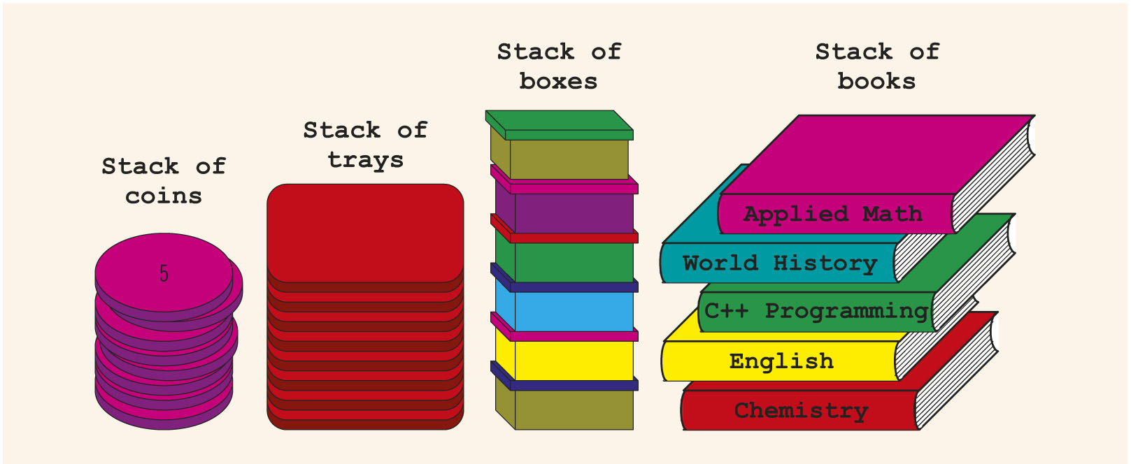
Stacks (2 of 4)
FIGURE 18-1 Various types of stacks

Slide 6
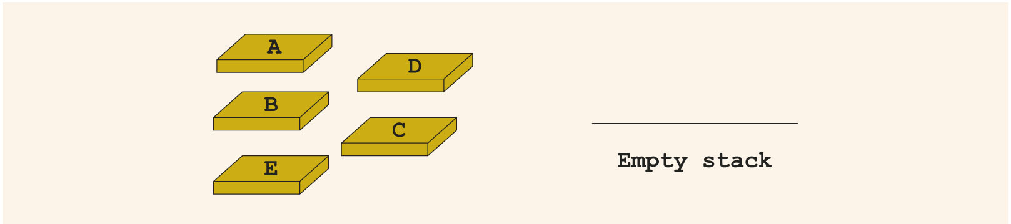
Stacks (3 of 4)
FIGURE 18-2 Empty stack

Slide 7
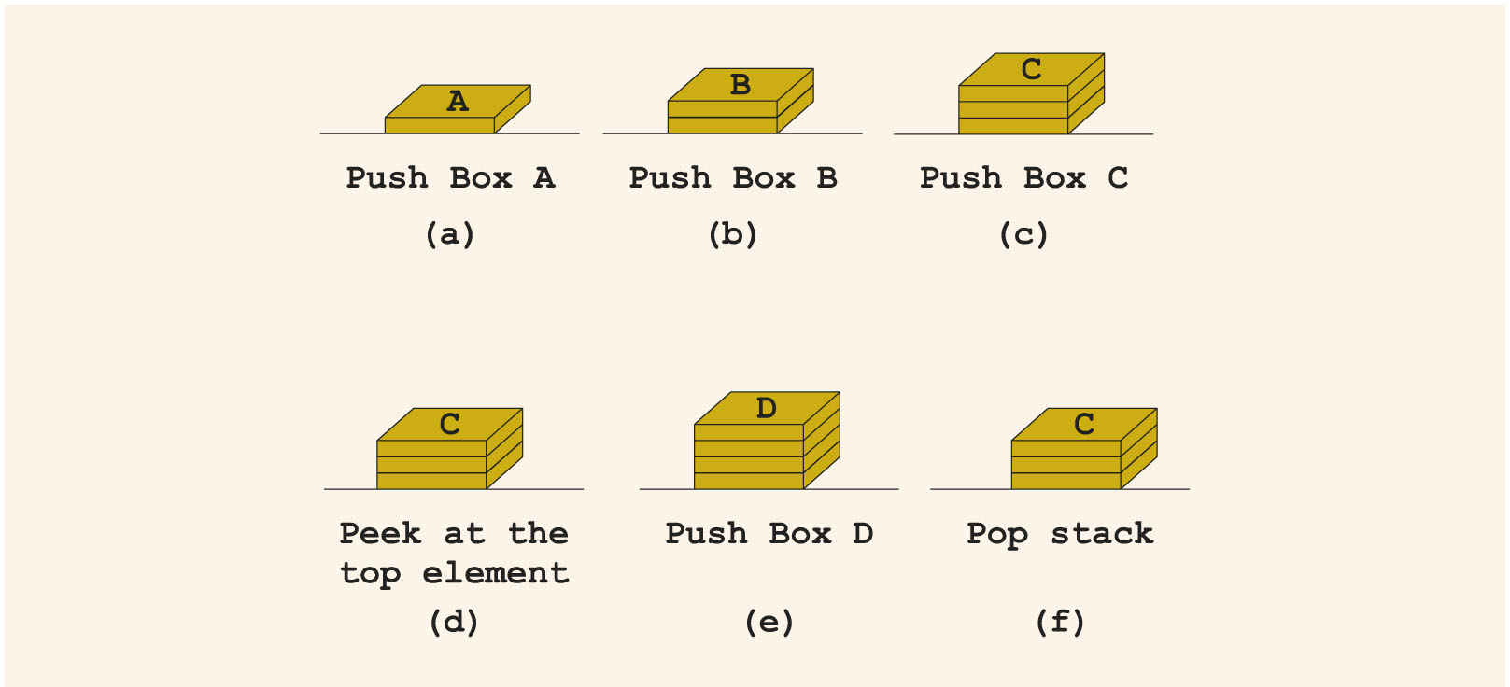
Stacks (4 of 4)
FIGURE 18-3 Stack operations

Slide 8
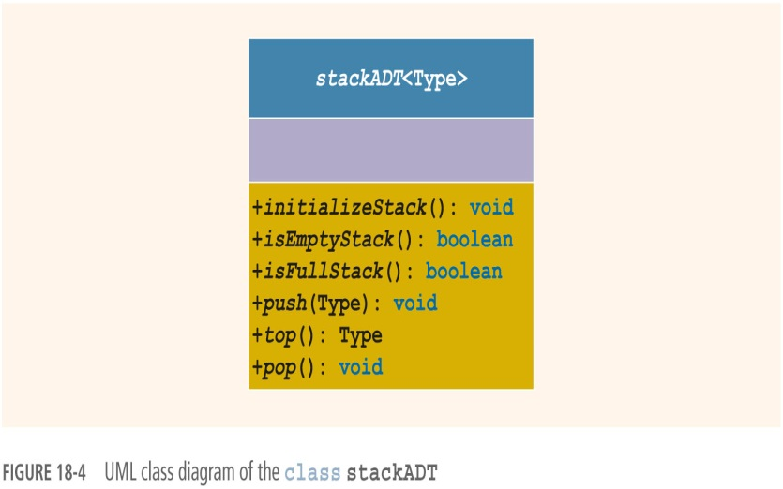
Stack Operations
In the abstract class stackADT:
initializeStack
isEmptyStack
isFullStack
push
top
pop
FIGURE 18-4 UML class diagram of the class stackADT

Slide 9
Implementation of Stacks as Arrays (1 of 5)
First element goes in first array position, second in the second position, etc.
Top of the stack is index of the last element added to the stack
Stack elements are stored in an array, which is a random access data structure
Stack element is accessed only through top
To track the top position, use a variable called stackTop

Slide 10
Implementation of Stacks as Arrays (2 of 5)
Can dynamically allocate array
Enables user to specify size of the array
class stackType implements the functions of the abstract class stackADT

Slide 11
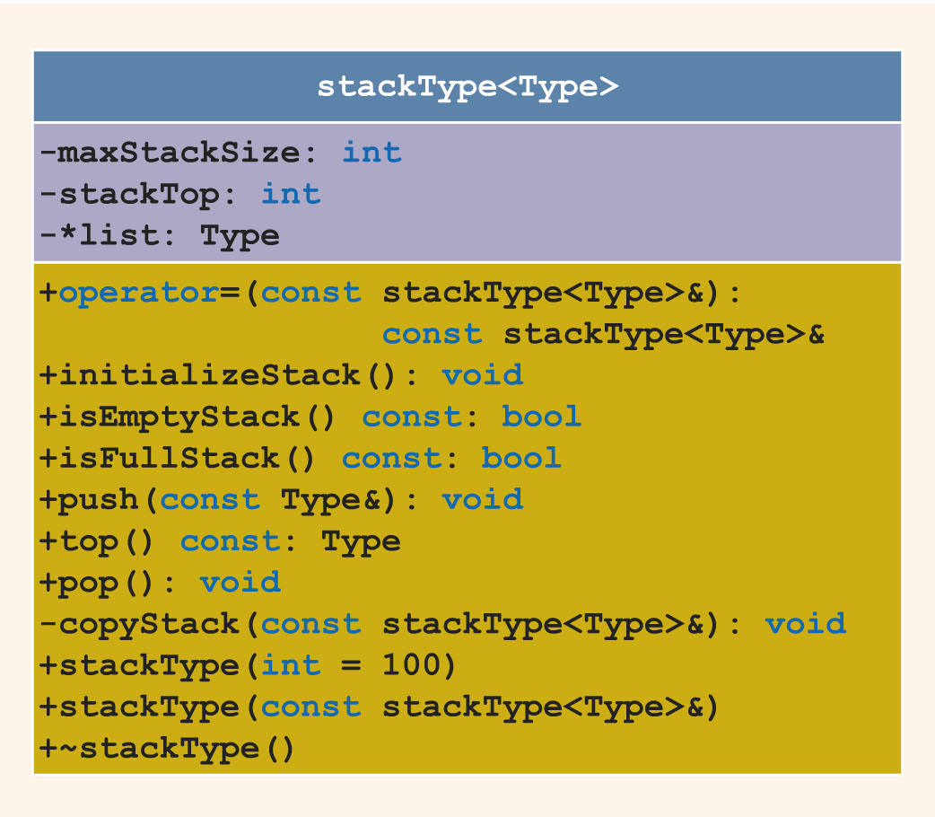
Implementation of Stacks as Arrays (3 of 5)
FIGURE 18-5 UML class diagram of the class stackType

Slide 12
Implementation of Stacks as Arrays (4 of 5)
C++ arrays begin with the index 0
Must distinguish between:
Value of stackTop
Array position indicated by stackTop
If stackTop is 0, stack is empty
If stackTop is nonzero, stack is not empty
Top element is given by stackTop - 1

Slide 13
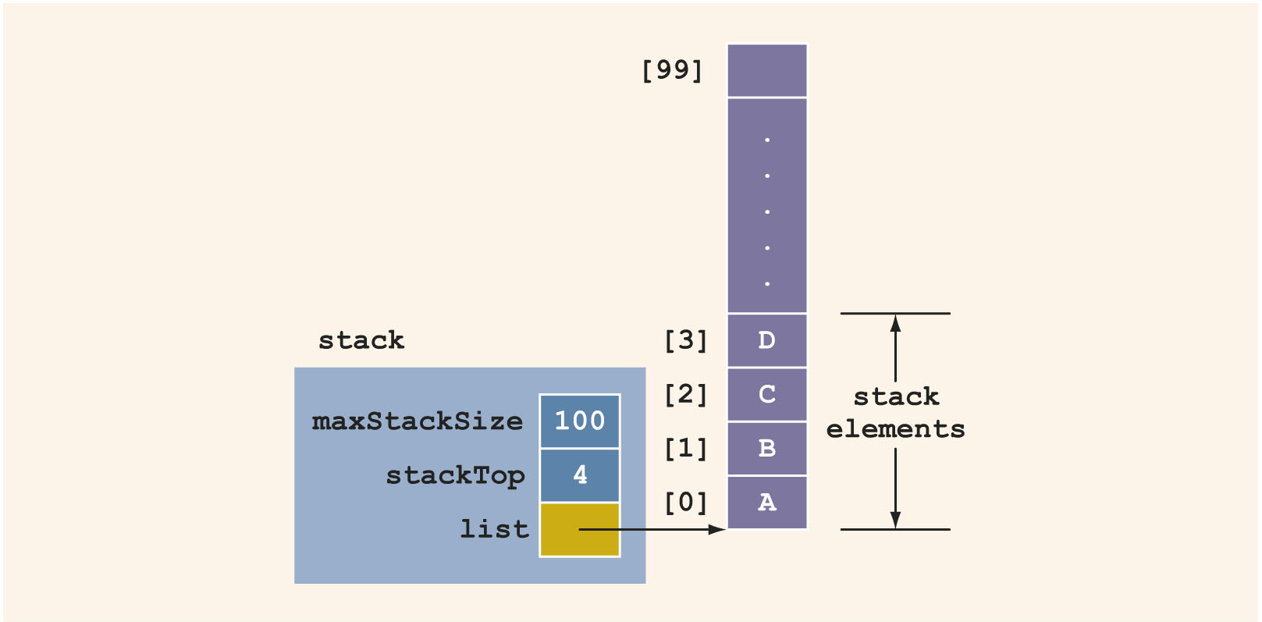
Implementation of Stacks as Arrays (5 of 5)
FIGURE 18-6 Example of a stack

Slide 14
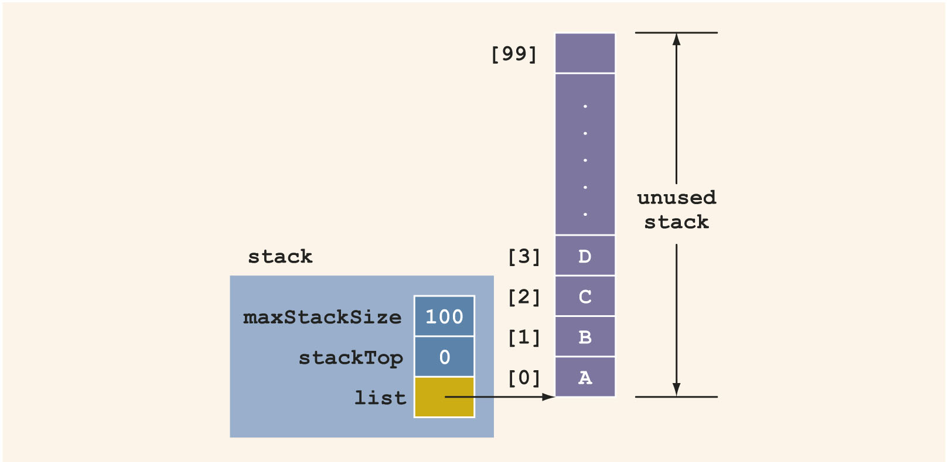
Initialize Stack
FIGURE 18-7 Empty stack

Slide 15
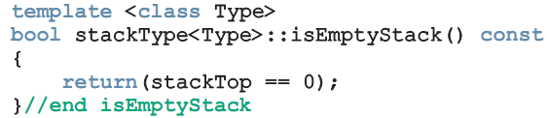
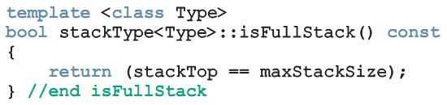
Empty Stack/Full Stack
Stack is empty if stackTop = 0
Stack is full if stackTop = maxStackSize

Slide 16
Push (1 of 3)
Store the newItem in the array component indicated by stackTop
Increment stackTop
Overflow occurs if we try to add a new item to a full stack

Slide 17
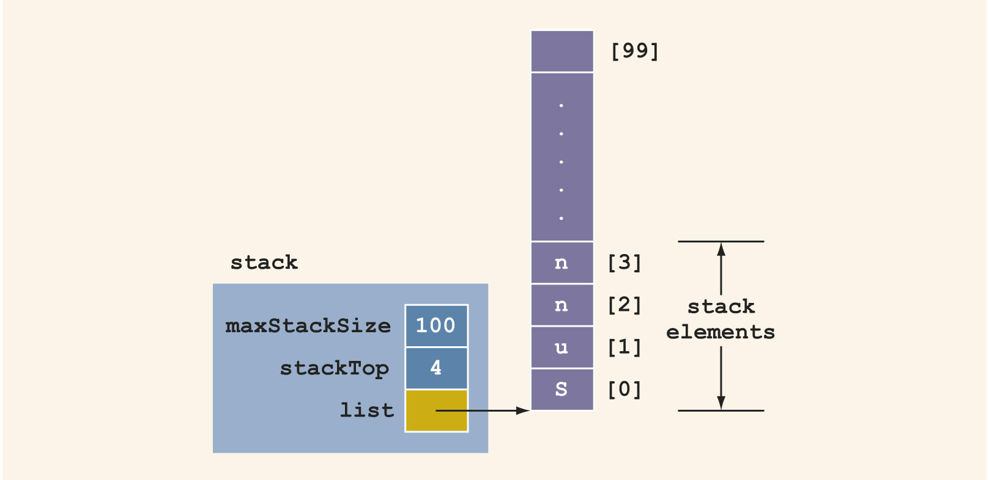
Push (2 of 3)
FIGURE 18-8 Stack before pushing y

Slide 18
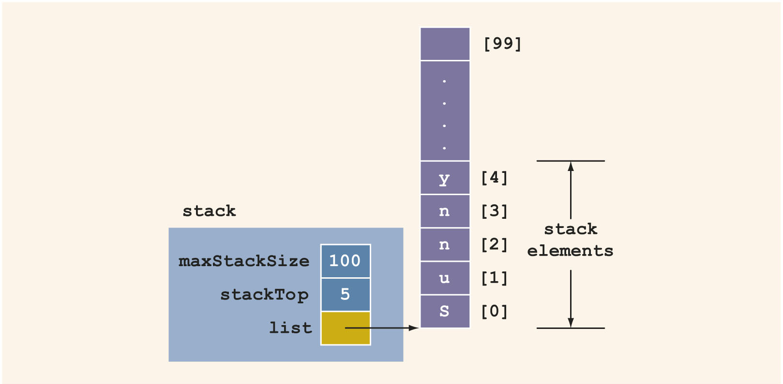
Push (3 of 3)
FIGURE 18-9 Stack after pushing y

Slide 19
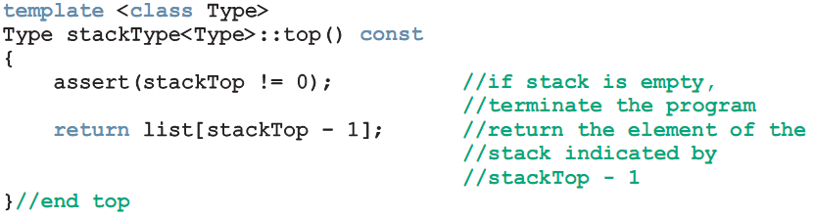
Return the Top Element
top operation:
Returns the top element of the stack

Slide 20
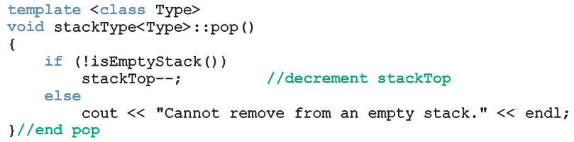
Pop (1 of 3)
To remove an element from the stack, decrement stackTop by 1
Underflow condition: trying to remove an item from an empty stack

Slide 21
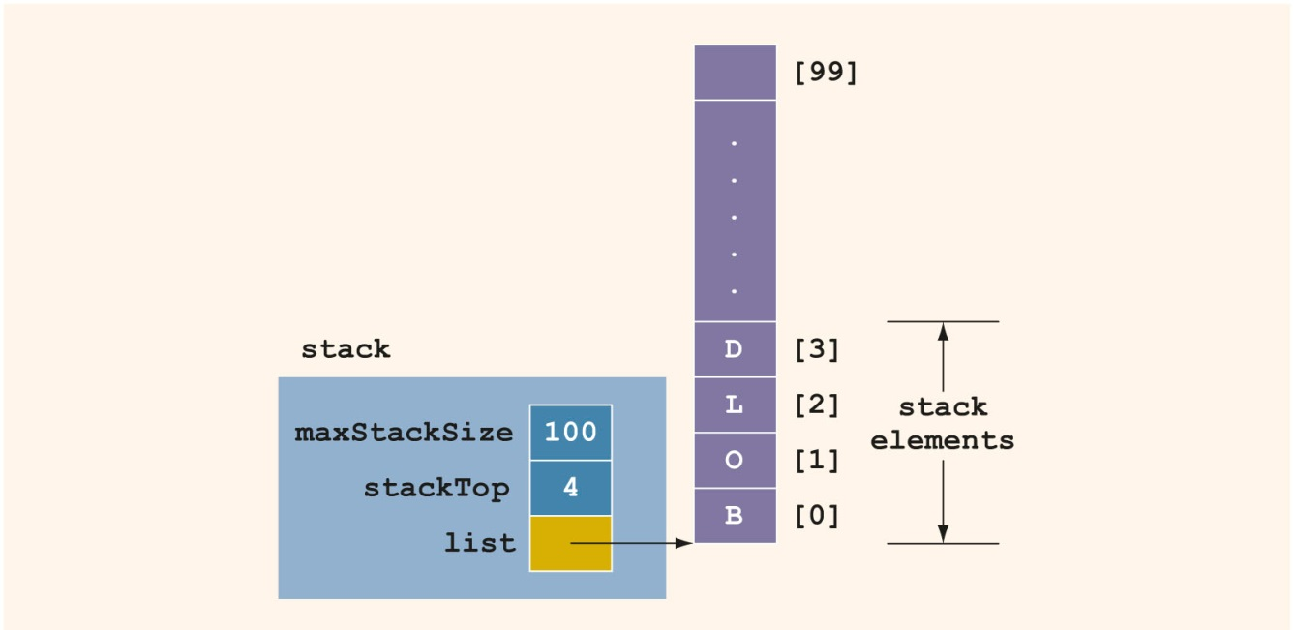
Pop (2 of 3)
FIGURE 18-10 Stack before popping D

Slide 22
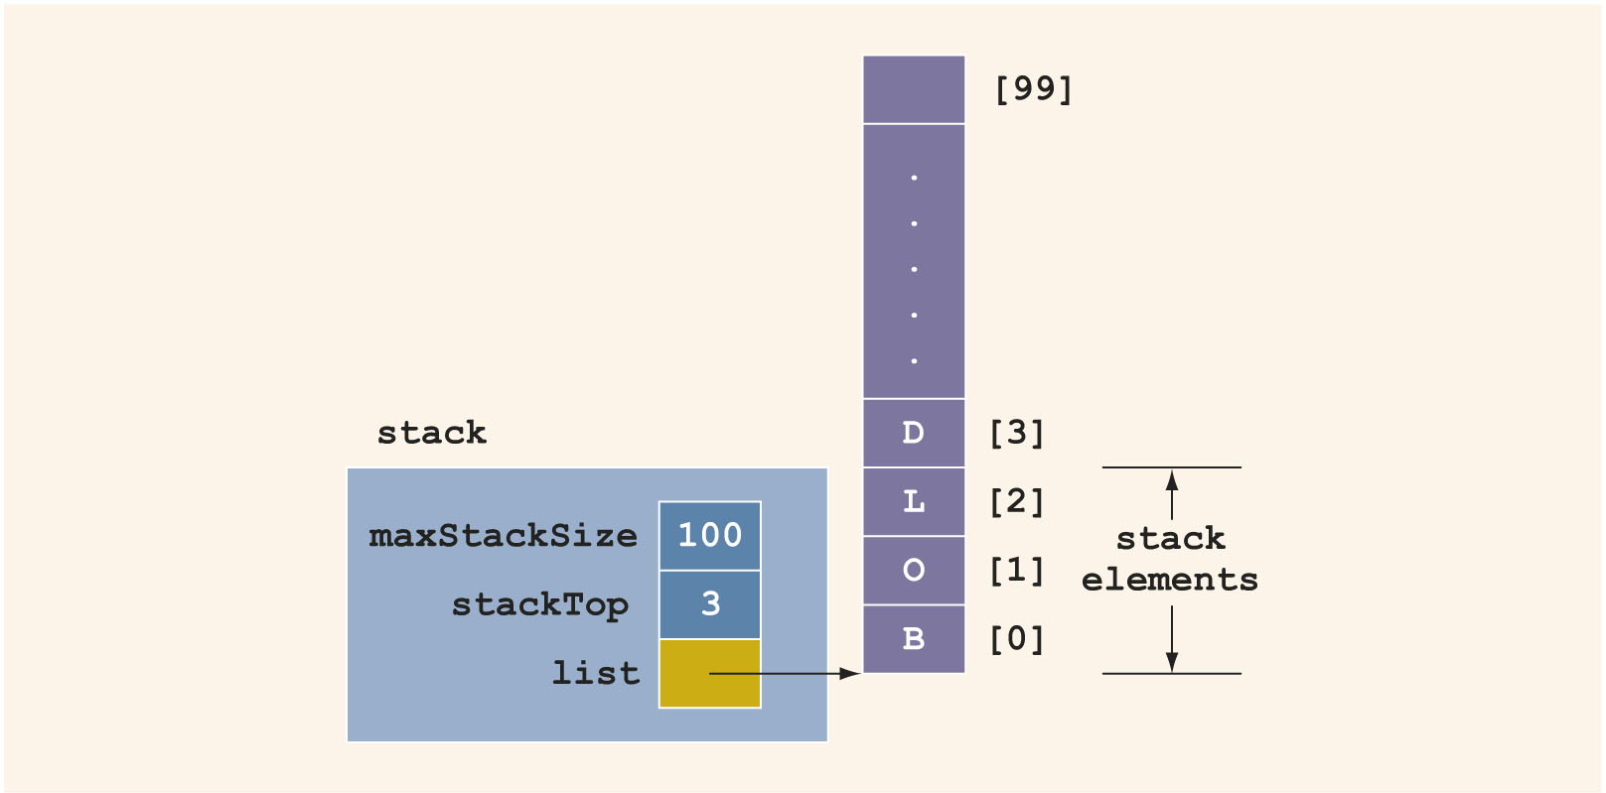
Pop (3 of 3)
FIGURE 18-11 Stack after popping D

Slide 23
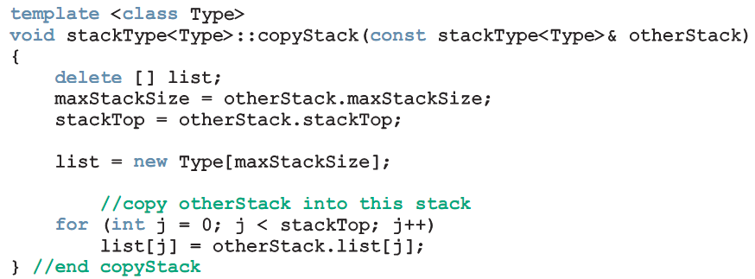
Copy Stack
copyStack function: copies a stack

Slide 24
Constructor and Destructor
Constructor:
Sets stack size to parameter value (or default value if not specified)
Sets stackTop to 0
Creates array to store stack elements
Destructor:
Deallocates memory occupied by the array
Sets stackTop to 0

Slide 25
Copy Constructor
Copy constructor:
Called when a stack object is passed as a (value) parameter to a function
Copies values of member variables from actual parameter to formal parameter

Slide 26
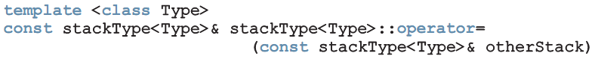
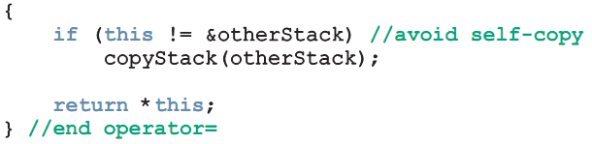
Overloading the Assignment Operator (=) (1 of 2)
Assignment operator must be explicitly overloaded because of pointer member variables

Slide 27
Stack Header File
Place definitions of class and functions (stack operations) together in a file
Called myStack.h

Slide 28
Linked Implementation of Stacks (1 of 2)
Array only allows fixed number of elements
If number of elements to be pushed exceeds array size, the program may terminate
Linked lists can dynamically organize data
In a linked representation, stackTop is pointer to memory address of top element in stack

Slide 29
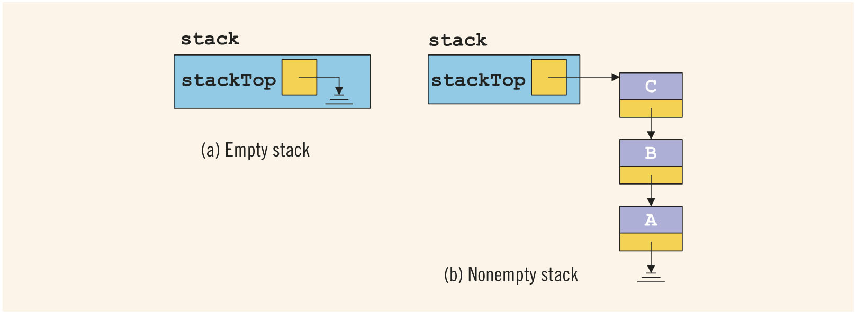
Linked Implementation of Stacks (2 of 2)
FIGURE 18-12 Empty and nonempty linked stack

Slide 30
Default Constructor
Initializes the stack to an empty state when a stack object is declared
Sets stackTop to nullptr
template <class Type>
linkedStackType<Type>::linkedStackType()
{
stackTop = nullptr;
}

Slide 31
Empty Stack and Full Stack
In a linked implementation of stacks, function isFullStack does not apply
Logically, the stack is never full
Stack is empty if stackTop is nullptr

Slide 32
Linked Stack: Initialize Stack
initializeStack: reinitializes stack to an empty state
Must deallocate memory occupied by current element
Sets stackTop to nullptr

Slide 33
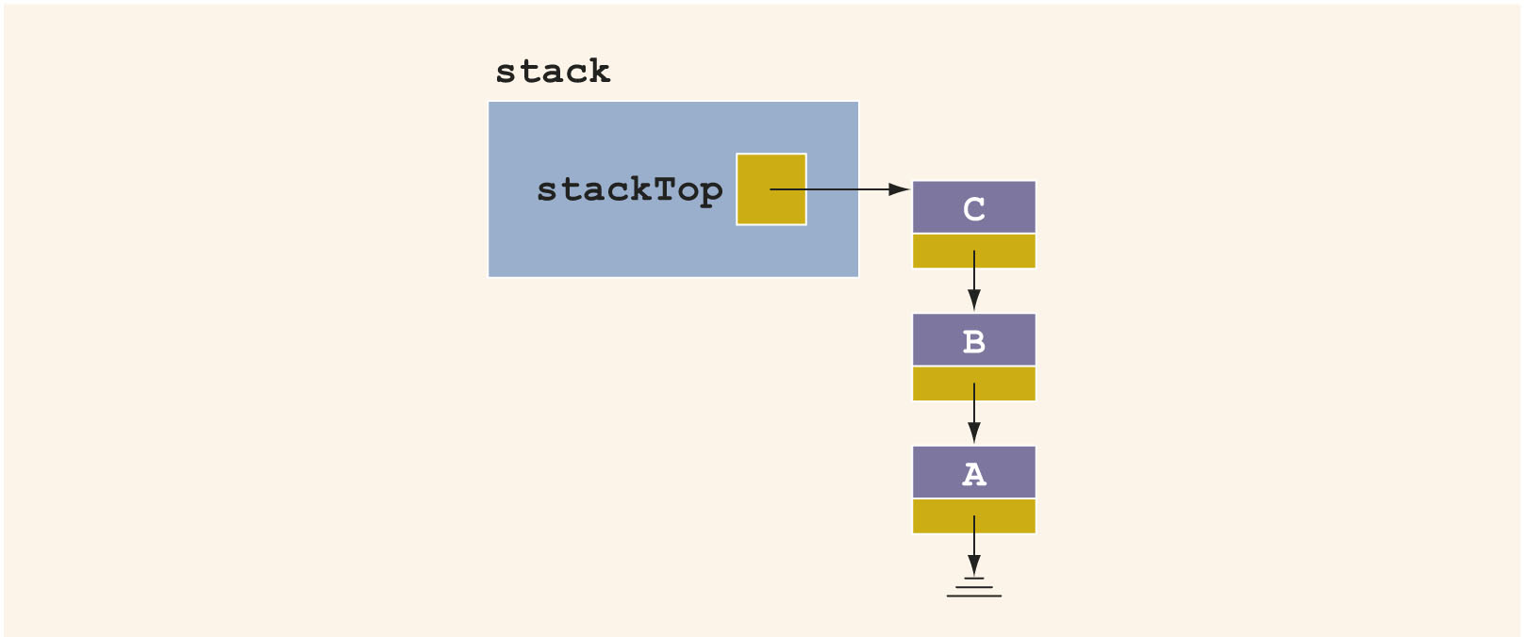
Push (1 of 2)
newNode is added at the beginning of the linked list pointed to by stackTop
FIGURE 18-13 Stack before the push operation

Slide 34
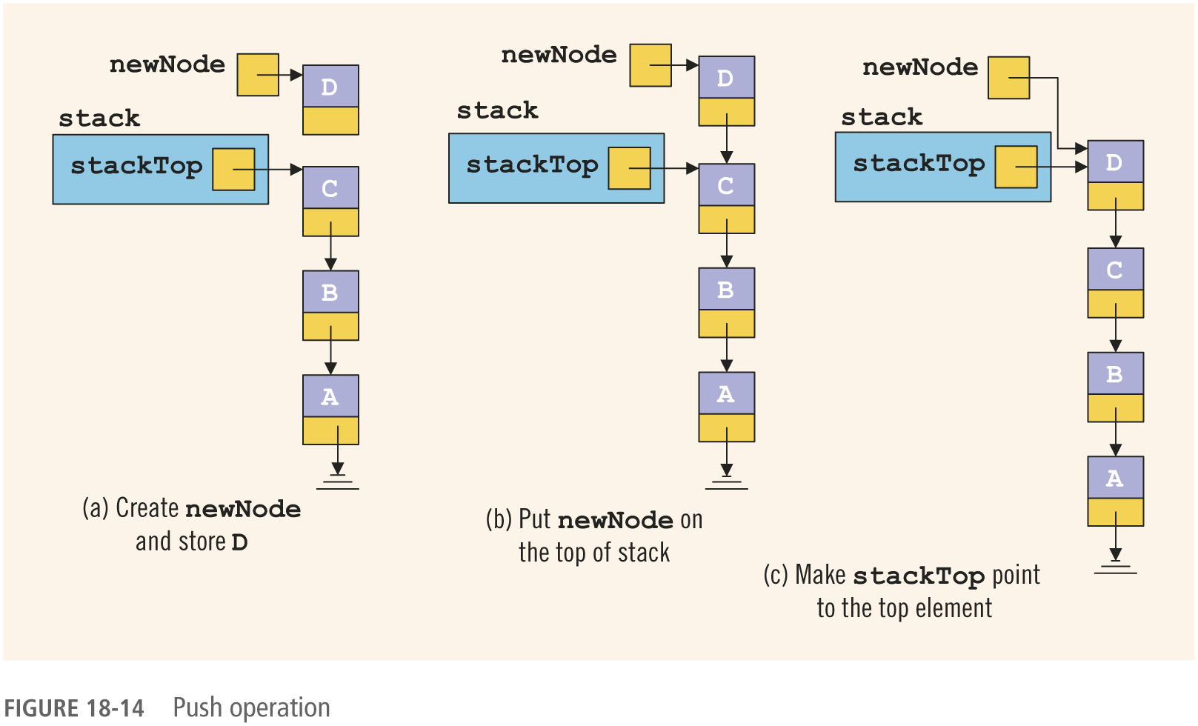
Push (2 of 2)
FIGURE 18-14 Push operation

Slide 35
Linked Stack: Return the Top Element
template <class Type>
Type linkedStackType<Type>::top() const
{
assert(stackTop != nullptr); //if stack is empty,
//terminate the program
return stackTop->info; //return the top element
}//end top

Slide 36
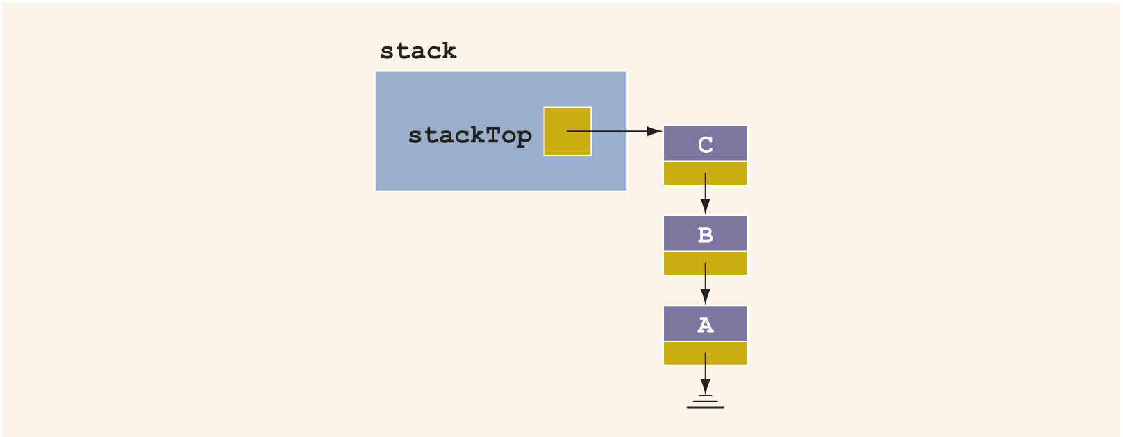
Pop (1 of 2)
Node pointed to by stackTop is removed
Second element becomes top element
FIGURE 18-15 Stack before the pop operation

Slide 37
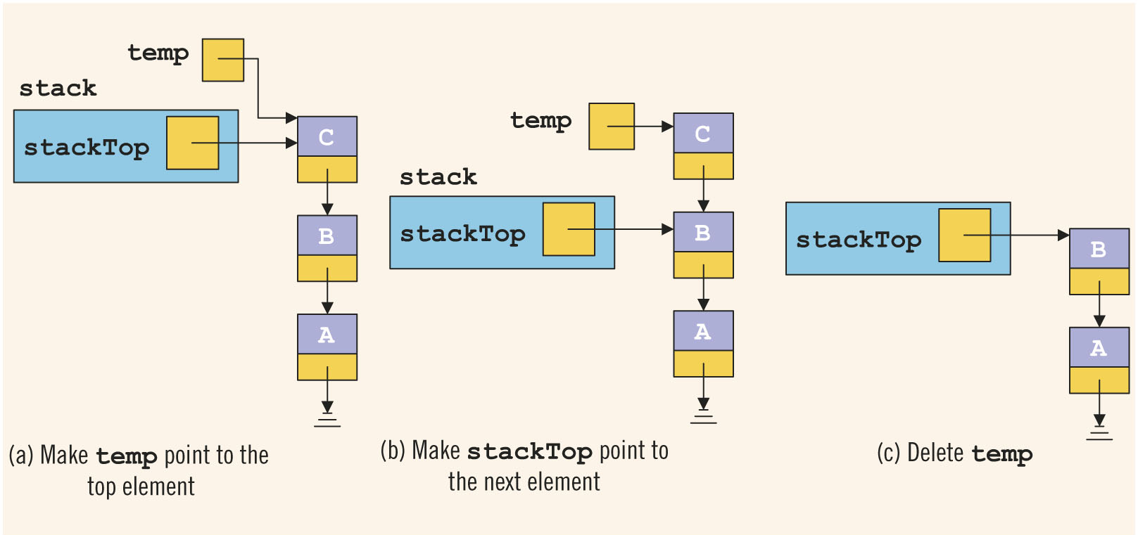
Pop (2 of 2)
FIGURE 18-16 Pop operation

Slide 38
Linked Stack: Copy Stack
copyStack function: makes an identical copy of a stack
Similar definition to copyList for linked lists

Slide 39
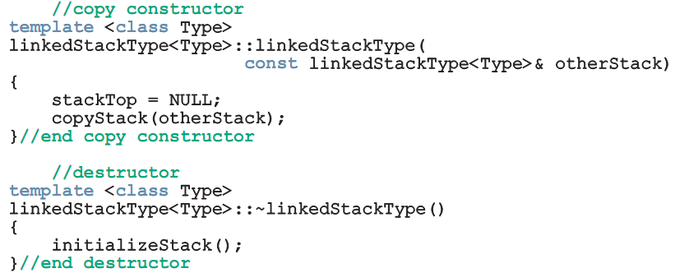
Constructors and Destructors
Copy constructor and destructor:
Similar to those for linked lists

Slide 40
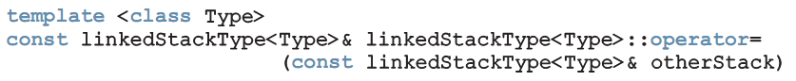
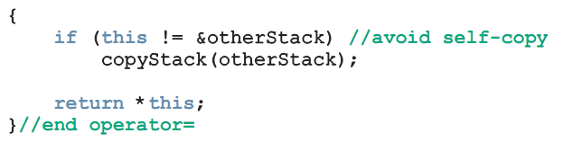
Overloading the Assignment Operator (=) (2 of 2)
Overloading the assignment operator:

Slide 41
Stack as Derived from the class unorderedLinkedList
Implementation of push is similar to insertFirst for general lists
Other similar functions:
initializeStack and initializeList
isEmptyList and isEmptyStack
linkedStackType can be derived from linkedListType
class linkedListType is abstract
unorderedLinkedListType is derived from linkedListType
Provides the definitions of the abstract functions of the class linkedListType
linkedStackType is derived from unorderedLinkedListType

Slide 42
Application of Stacks: Postfix Expressions Calculator (1 of 8)
Infix notation: usual notation for writing arithmetic expressions
Operator is written between the operands
Example: a + b
Evaluates from left to right
Operators have precedence
Parentheses can be used to override precedence

Slide 43
Application of Stacks: Postfix Expressions Calculator (2 of 8)
Prefix (Polish) notation: operators are written before the operands
Introduced by the Polish mathematician Jan Lukasiewicz in early 1920s
Parentheses can be omitted
Example: + a b

Slide 44
Application of Stacks: Postfix Expressions Calculator (3 of 8)
Reverse Polish notation: operators follow the operands (postfix operators)
Proposed by Australian philosopher and early computer scientist Charles L. Hamblin in the late 1950s
Advantage: operators appear in the order required for computation
Example: a + b * c becomes a b c * +

Slide 45
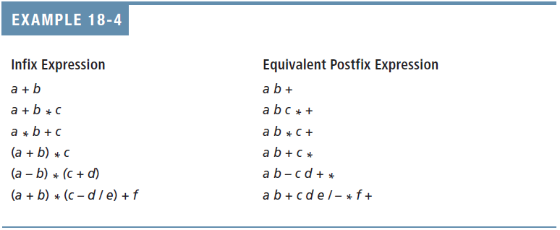
Application of Stacks: Postfix Expressions Calculator (4 of 8)

Slide 46
Application of Stacks: Postfix Expressions Calculator (5 of 8)
Postfix notation has important applications in computer science
Many compilers first translate arithmetic expressions into postfix notation and then translate this expression into machine code
Evaluation algorithm:
Scan expression from left to right
When an operator is found, back up to get operands, perform the operation, and continue

Slide 47
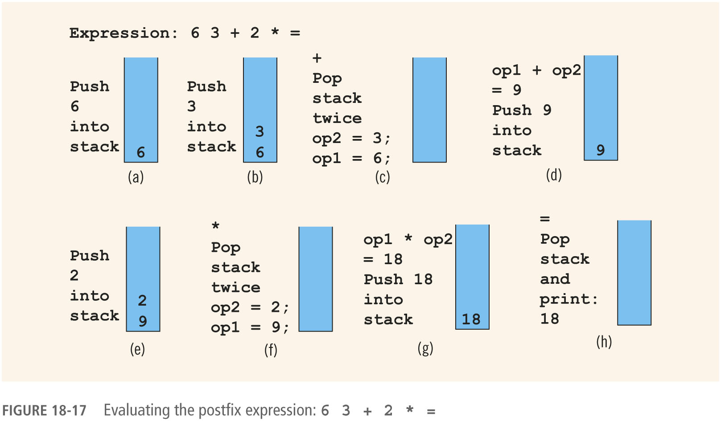
Application of Stacks: Postfix Expressions Calculator (6 of 8)
FIGURE 18-17 Evaluating the postfix expression: 6 3 + 2 * =

Slide 48
Application of Stacks: Postfix Expressions Calculator (7 of 8)
Symbols can be numbers or anything else:
+, -, *, and / are operators, require two operands
Pop stack twice and evaluate expression
If stack has less than two elements → error
If symbol is =, expression ends
Pop and print answer from stack
If stack has more than one element → error
If symbol is anything else
Expression contains an illegal operator

Slide 49
Application of Stacks: Postfix Expressions Calculator (8 of 8)
Assume postfix expressions are in this form:
#6 #3 + #2 * =
If symbol scanned is #, next input is a number
If the symbol scanned is not #, then it is:
An operator (may be illegal) or
An equal sign (end of expression)
Assume expressions contain only +, -, *, and / operators

Slide 50
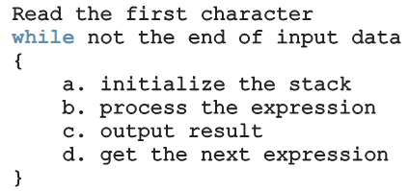
Main Algorithm
Pseudocode:
Four functions are needed:
evaluateExpression, evaluateOpr, discardExp, and printResult

Slide 51
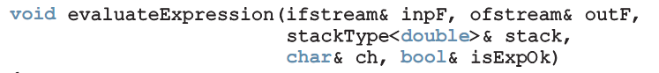
Function evaluateExpression
Function evaluateExpression:
Evaluates each postfix expression
Each expression ends with = symbol

Slide 52
Function evaluateOpr
Function evaluateOpr:
Evaluates an expression
Needs two operands saved in the stack
If less than two → error
Also checks for illegal operations

Slide 53
Function discardExp
Function discardExp:
Called when an error is discovered in expression
Reads and writes input data until the ‘=’

Slide 54
Function printResult
The function printResult: If the postfix expression contains no errors, it prints the result
Otherwise, it outputs an appropriate message
Result of the expression is in the stack, and output is sent to a file

Slide 55
Nonrecursive Algorithm to Print a Linked List Backward (1 of 7)
To print a list backward nonrecursively, first get to the last node of the list
Problem: Links go in only one direction
Solution: Save a pointer to each of node in a stack
Uses the LIFO principle
Since number of nodes is usually not known, use the linked implementation of a stack

Slide 56
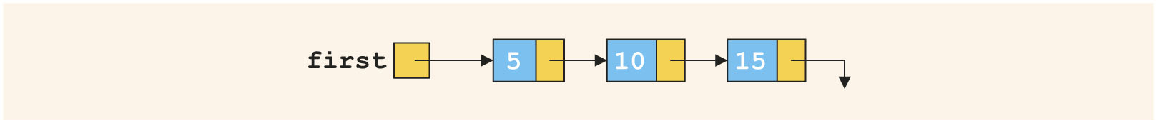
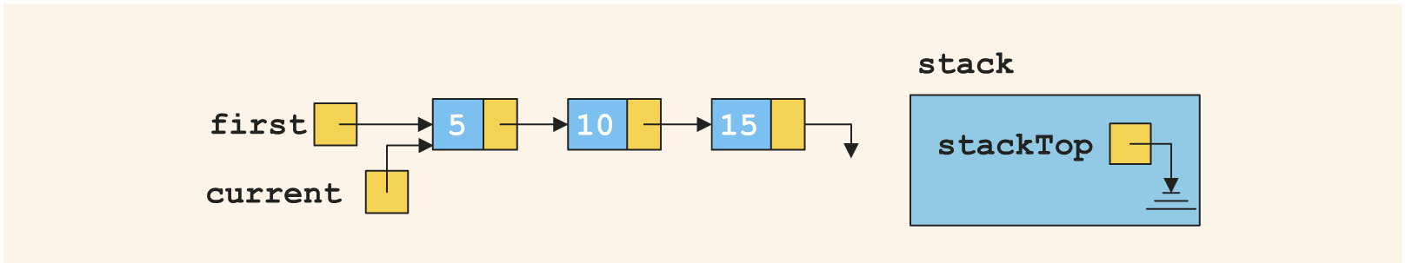
Nonrecursive Algorithm to Print a Linked List Backward (2 of 7)
FIGURE 18-18 Linked list
FIGURE 18-19 List after the statement current = first; executes

Slide 57
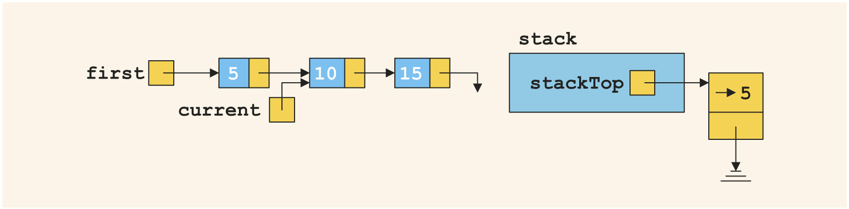
Nonrecursive Algorithm to Print a Linked List Backward (3 of 7)
FIGURE 18-20 List and stack after the statements stack.push(current); and current = current->link; execute

Slide 58
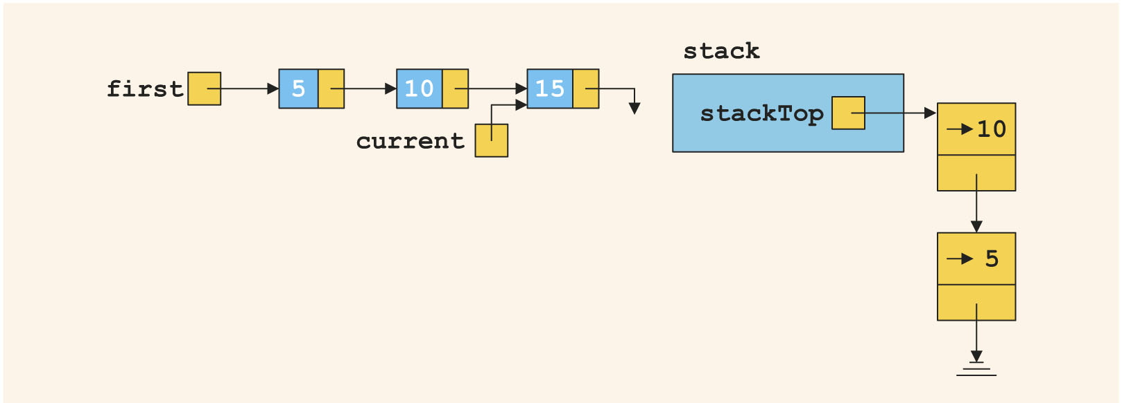
Nonrecursive Algorithm to Print a Linked List Backward (4 of 7)
FIGURE 18-21 List and stack after the statements stack.push(current); and current = current->link; execute

Slide 59
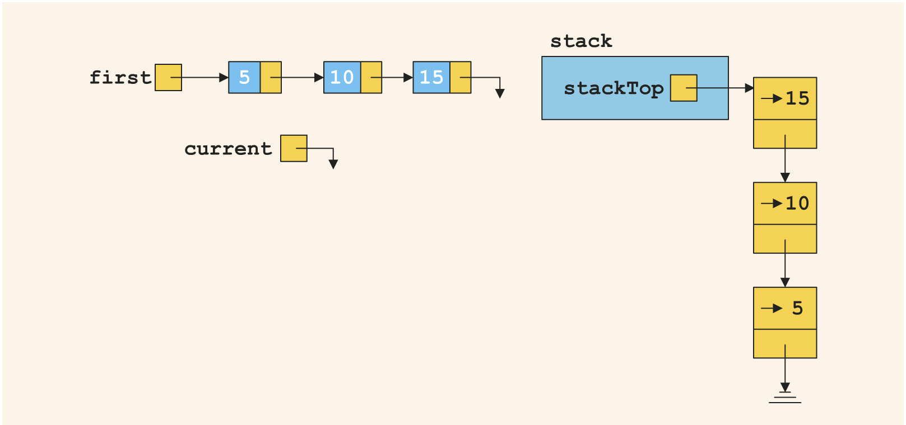
Nonrecursive Algorithm to Print a Linked List Backward (5 of 7)
FIGURE 18-22 List and stack after the statements stack.push(current); and current =current->link; execute

Slide 60
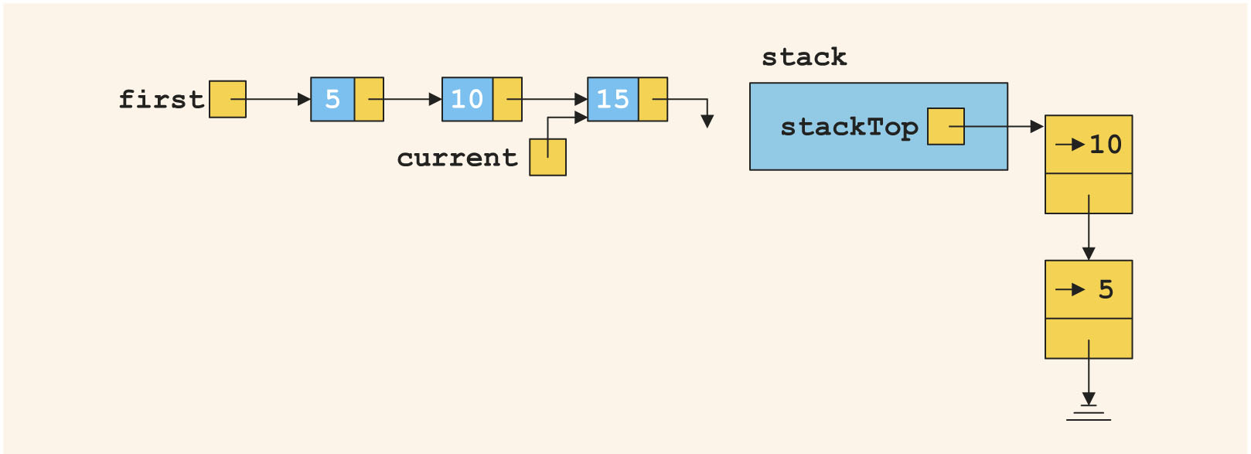
Nonrecursive Algorithm to Print a Linked List Backward (6 of 7)
FIGURE 18-23 List and stack after the statements current = stack.top(); and stack. pop(); execute

Slide 61
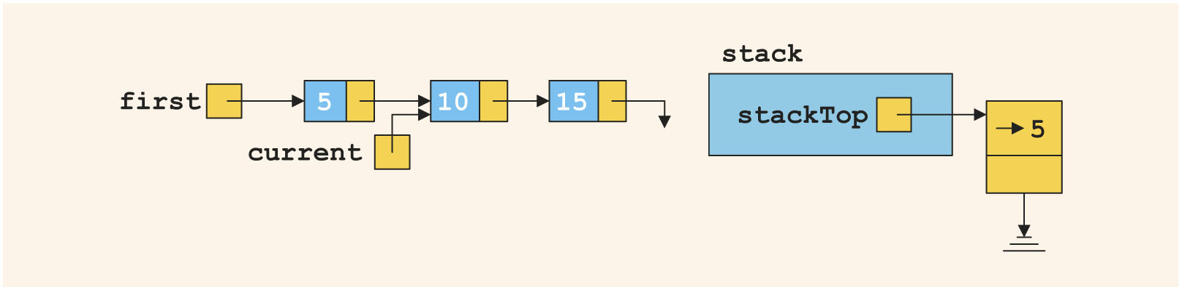
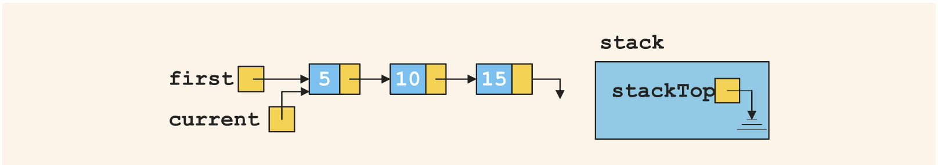
Nonrecursive Algorithm to Print a Linked List Backward (7 of 7)
FIGURE 18-24 List and stack after the statements current=stack.top(); and stack.pop(); execute
FIGURE 18-25 List and stack after the statements current=stack.top(); and stack.pop(); execute

Slide 62
Queues
Queue: set of elements of the same type
Elements are:
Added at one end (the back or rear)
Deleted from the other end (the front)
First In First Out (FIFO) data structure
Middle elements are inaccessible
Example:
Waiting line in a bank

Slide 63
Queue Operations
Queue operations include:
initializeQueue
isEmptyQueue
isFullQueue
front
back
addQueue
deleteQueue
Abstract class queueADT defines these operations

Slide 64
Implementation of Queues as Arrays (1 of 15)
Need at least four (member) variables:
Array to store queue elements
queueFront and queueRear
To track first and last elements
maxQueueSize
To specify maximum size of the queue

Slide 65
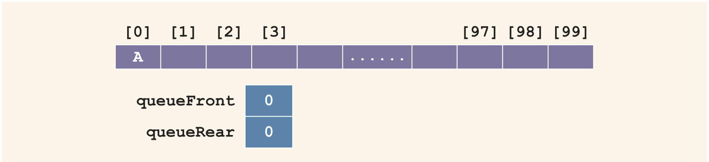
Implementation of Queues as Arrays (2 of 15)
To add an element to the queue:
Advance queueRear to next array position
Add element to position pointed by queueRear
FIGURE 18-26 Queue after the first addQueue operation

Slide 66
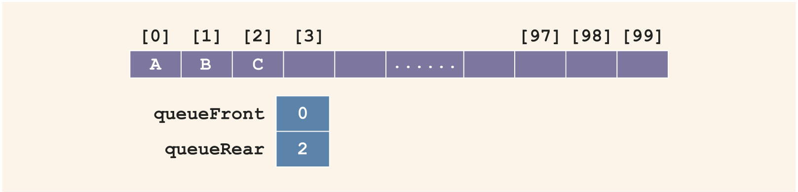
Implementation of Queues as Arrays (3 of 15)
FIGURE 18-27 Queue after two more addQueue operations

Slide 67

Implementation of Queues as Arrays (4 of 15)
To delete an element from the queue:
Retrieve element pointed to by queueFront
Advance queueFront to next queue element
FIGURE 18-28 Queue after the deleteQueue operation

Slide 68
Implementation of Queues as Arrays (5 of 15)
Will this queue design work?
Let A represent adding an element to the queue
Let D represent deleting an element from the queue
Consider the following sequence of operations:
AAADADADADADADADA...

Slide 69
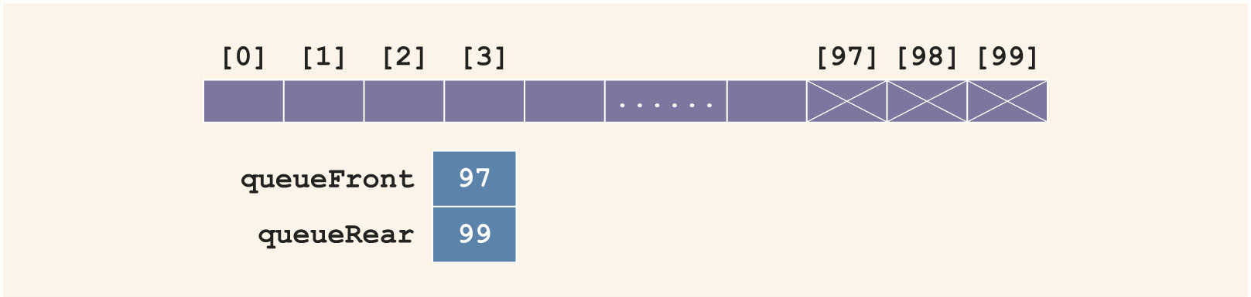
Implementation of Queues as Arrays (6 of 15)
This would eventually set queueRear to point to the last array position
Giving the impression that the queue is full
FIGURE 18-29 Queue after the sequence of operations AAADADADADADA . . .

Slide 70
Implementation of Queues as Arrays (7 of 15)
Solution 1: When queue overflows at rear (queueRear points to the last array position):
Check value of queueFront
If queueFront indicates there is room at front of array, slide all queue elements toward the first array position
Problem: too slow for large queues
Solution 2: Assume that the array is circular

Slide 71
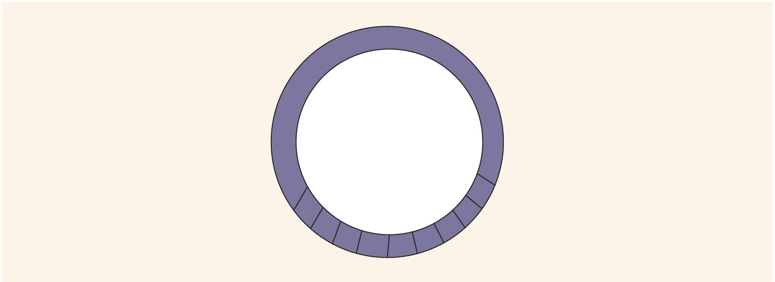
Implementation of Queues as Arrays 8 of 15)
FIGURE 18-30 Circular queue

Slide 72
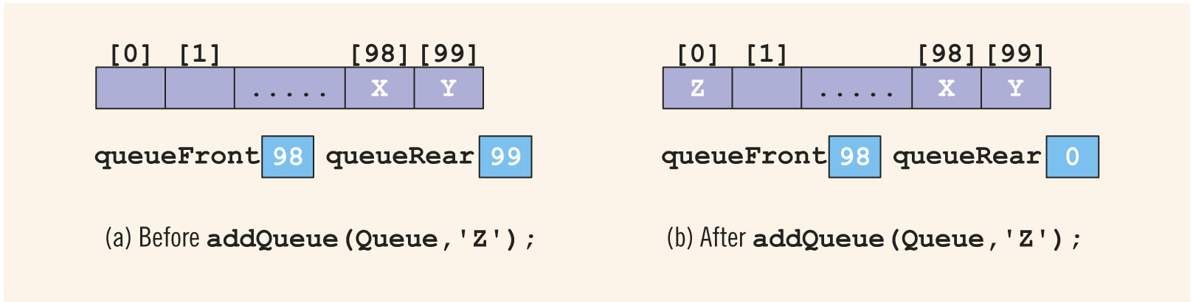
Implementation of Queues as Arrays (9 of 15)
FIGURE 18-31 Queue before and after the add operation

Slide 73
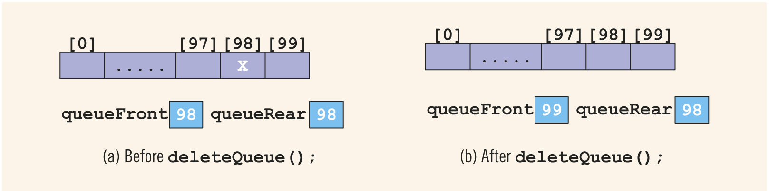
Implementation of Queues as Arrays (10 of 15)
Deletion Case 1:
FIGURE 18-32 Queue before and after the delete operation

Slide 74
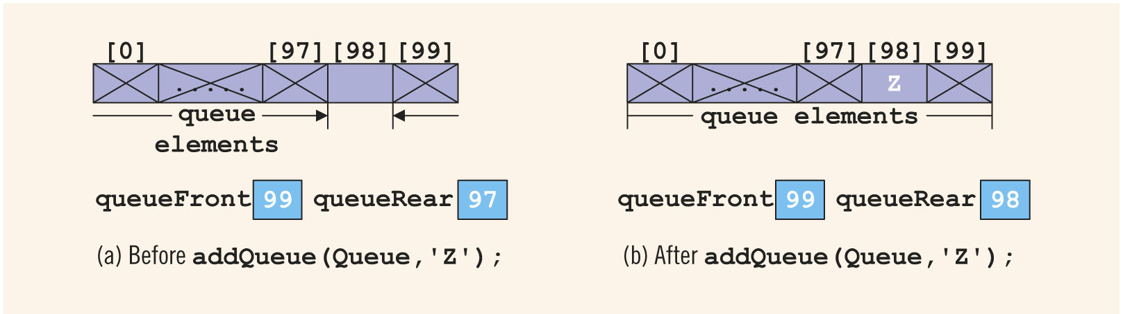
Implementation of Queues as Arrays (11 of 15)
Deletion Case 2:
FIGURE 18-33 Queue before and after the add operation

Slide 75
Implementation of Queues as Arrays (12 of 15)
Problem:
Figures 18-32b and 18-33b have identical values for queueFront and queueRear
However, Figure 18-32b represents an empty queue, whereas Figures 18-33b shows a full queue
Solution?

Slide 76
Implementation of Queues as Arrays (13 of 15)
Solution 1: keep a count
Incremented when a new element is added to the queue
Decremented when an element is removed
Initially set to 0
Very useful if user (of queue) frequently needs to know the number of elements in the queue

Slide 77
Implementation of Queues as Arrays (14 of 15)
Solution 2: Let queueFront indicate index of array position preceding the first element
queueRear still indicates index of last one
Queue empty if:
queueFront == queueRear
Slot indicated by queueFront is reserved
Queue is full if next available space is the reserved slot indicated by queueFront

Slide 78
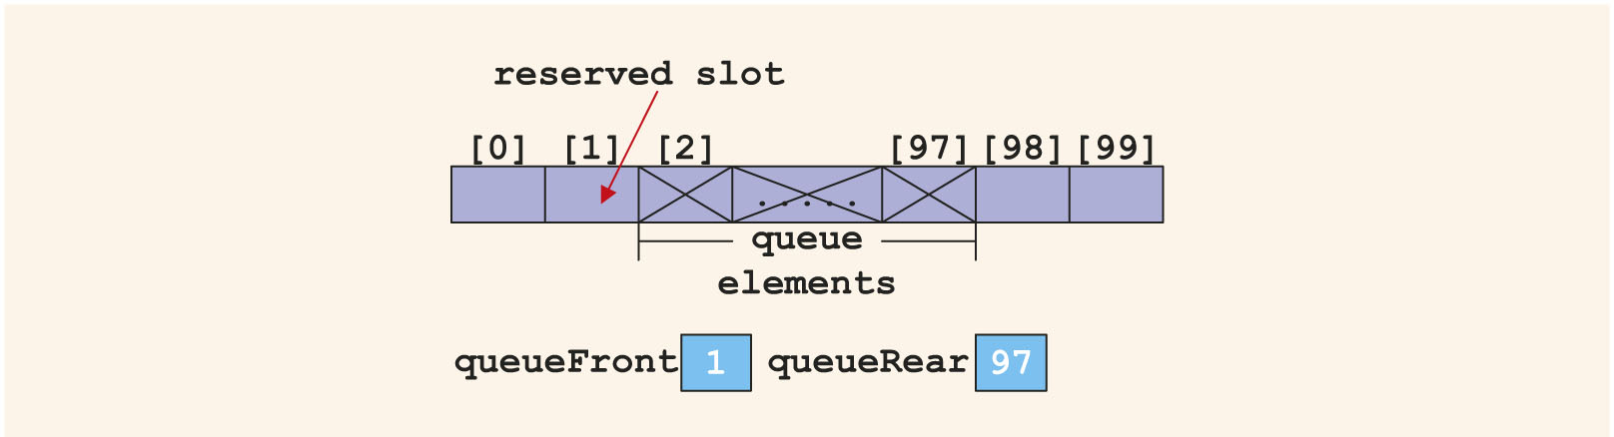
Implementation of Queues as Arrays (15 of 15)
FIGURE 18-34 Array to store the queue elements with a reserved slot

Slide 79
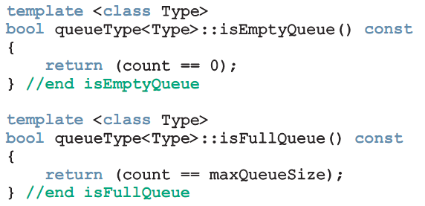
Empty Queue and Full Queue
Queue is empty if count ==0
Queue is full if count == maxQueueSize

Slide 80
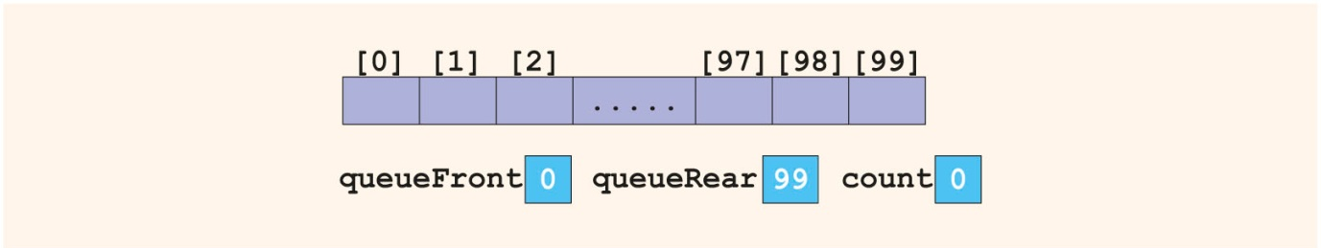
Initialize Queue
Initializes queue to empty state
First element is added at first array position
queueFront set to 0
queueRear set to maxQueueSize -1
count set to 0
FIGURE 18-35 Empty queue

Slide 81
Front and Back
front operation: returns the first element of the queue
If queue is empty, program terminates
back operation: returns the last element of the queue
If queue is empty, program terminates

Slide 82
addQueue
addQueue operation:
Advance queueRear to next array position
Add new element to array position indicated by queueRear
Increment count by 1

Slide 83
deleteQueue
deleteQueue operation:
Decrement count by 1
Advance queueFront to next queue element

Slide 84
Queue: Constructors and Destructors
Constructor:
Sets maxQueueSize to user specification
Creates array of size maxQueueSize (or default size)
Initializes queueFront and queueRear to indicate empty queue
Destructor:
Deallocates memory occupied by array

Slide 85
Linked Implementation of Queues (1 of 2)
Array implementation has issues:
Array size is fixed: only a finite number of queue elements can be stored in it
Requires array to be treated in a special way, together with queueFront and queueRear
Linked implementation of a queue simplifies many issues
Queue is never full because memory is allocated dynamically

Slide 86
Linked Implementation of Queues (2 of 2)
Elements are added at one end and removed from the other
Need only two pointers to maintain the queue: queueFront and queueRear

Slide 87
Empty and Full Queue
Queue is empty if queueFront is nullptr
Queue is never full
Unless the system runs out of memory
Note: must provide isFullQueue function definition because it is an abstract function in parent class queueADT

Slide 88
Linked Queue: Initialize Queue
Initializes queue to an empty state
Must remove all existing elements, if any
Deallocates memory occupied by elements

Slide 89
addQueue, front, back, and deleteQueue operations
addQueue operation: adds new element to end of queue
front operation: returns first element of queue
back operation: returns last element of queue
deleteQueue operation: removes first element of queue

Slide 90
Linked Queue: Constructors and Destructors
Constructor
Accesses maxQueueSize, queueFront, and queueRear
Destructor: destroys the queue
Deallocates memory occupied by elements
Copy constructor and overloading assignment operator:
Similar to corresponding function for stack

Slide 91
Queue Derived from the class unorderedLinkedListType
Linked implementation of queue: similar to implementation of a linked list created in a forward manner
addQueue similar to insertFirst
initializeQueue is like initializeList
isEmptyQueue similar to isEmptyList
deleteQueue can be implemented as before
queueFront is same as first
queueRear is same as last

Slide 92
Application of Queues: Simulation
Simulation: a technique in which one system models the behavior of another system
Computer models are used to study the behavior of real systems
Queuing systems: computer simulations using queues as the data structure
Queues of objects are waiting to be served

Slide 93
Designing a Queuing System (1 of 3)
Server: object that provides the service
Customer: object receiving the service
Transaction time: service time, or the time it takes to serve a customer
Model: system that consists of a list of servers and a waiting queue holding the customers to be served
Customer at front of queue waits for the next available server

Slide 94
Designing a Queuing System (2 of 3)
Need to know:
Number of servers
Expected arrival time of a customer
Time between the arrivals of customers
Number of events affecting the system
Performance of system depends on:
How many servers are available
How long it takes to serve a customer
How often a customer arrives

Slide 95
Designing a Queuing System (3 of 3)
If it takes too long to serve a customer and customers arrive frequently, then more servers are needed
System can be modeled as a time-driven simulation
Time-driven simulation: the clock is a counter
The passage of one unit of time can be implemented by incrementing a counter by 1
Simulation is run for a fixed amount of time

Slide 96
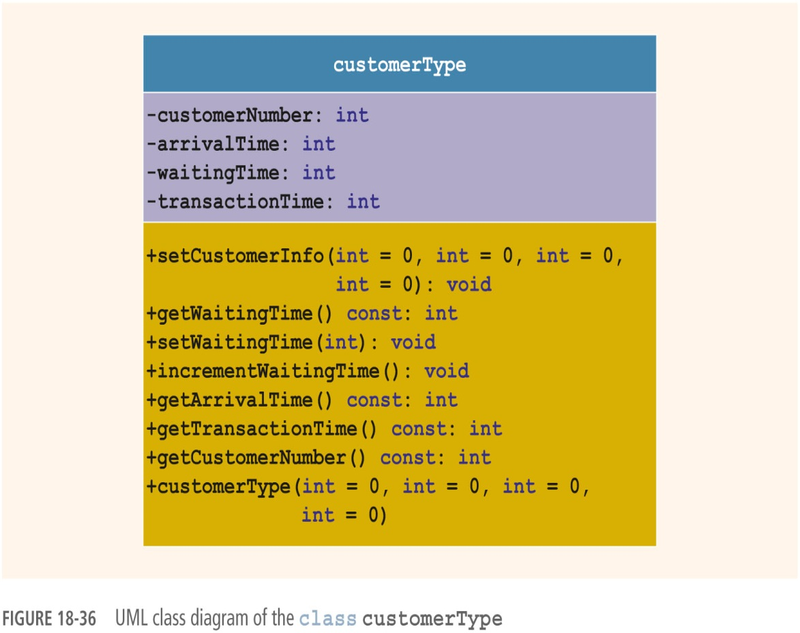
Customer
FIGURE 18-36 UML class diagram of the class customerType

Slide 97
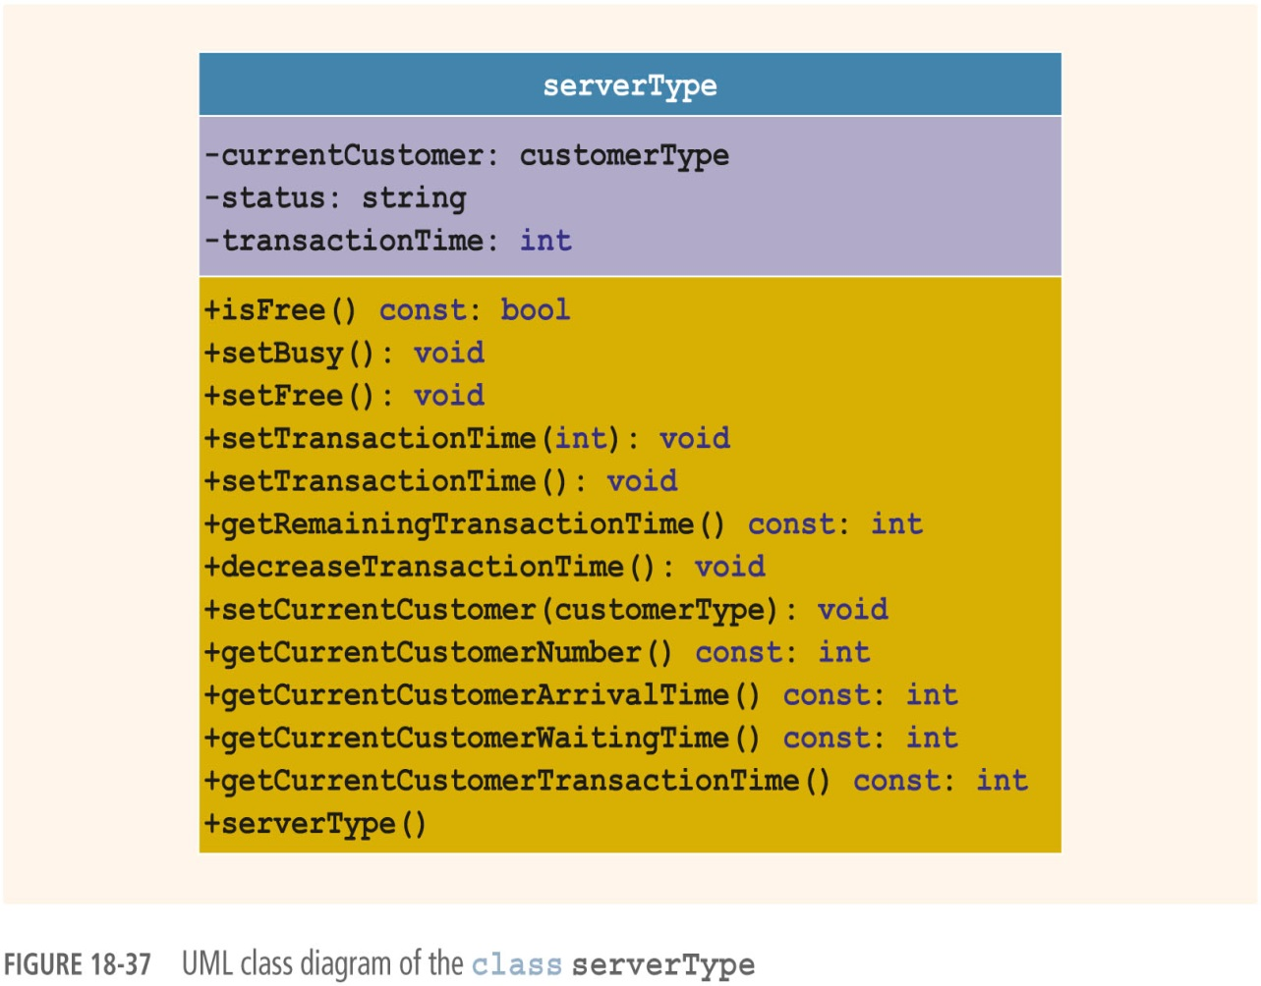
Server
FIGURE 18-37 UML class diagram of the class serverType

Slide 98

Server List
Server list: a set of servers
At any given time, a server is either free or busy
FIGURE 18-38 UML class diagram of the class serverListType

Slide 99
Waiting Customers Queue
When customer arrives, he/she goes to end of queue
When a server becomes available, customer at front of queue leaves to conduct the transaction
After each time unit, the waiting time of each customer in the queue is incremented by 1
Can use queueType but must add an operation to increment waiting time

Slide 100

Main Program
Algorithm for main loop:

Slide 101
Summary (1 of 2)
Stack: items are added/deleted from one end
Last In First Out (LIFO) data structure
Operations: push, pop, initialize, destroy, check for empty/full stack
Can be implemented as array or linked list
Middle elements should not be accessed directly
Postfix notation: operators are written after the operands (no parentheses needed)

Slide 102
Summary (2 of 2)
Queue: items are added at one end and removed from the other end
First In First Out (FIFO) data structure
Operations: add, remove, initialize, destroy, check if queue is empty/full
Can be implemented as array or linked list
Middle elements should not be accessed directly
Is a restricted version of array and linked list

